Slide 1
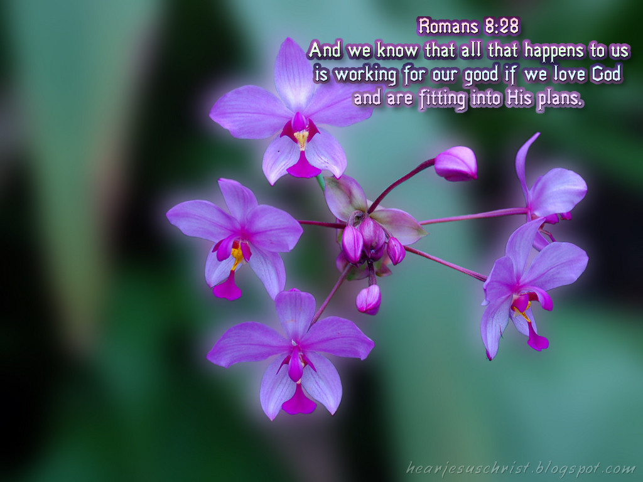


Romans 8:28
God works all things together for our good
CWC

Slide 2
Reading of The Word
Open Your Bibles to
Romans 8:28
New International Version
CWC

Slide 3

²⁸ And we know that in all things God works for the good of those who love him, who have been called according to his purpose.
CWC

Slide 4
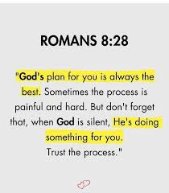
CWC

Slide 5
Introduction
God is sovereign over all things.
God arranges everything for our good.
III. God works all things together for good only for His chosen people who love Him.
CWC

Slide 6
I. God is sovereign over all things.
God is in charge! Eph.1:11 Pr.21:1 Ps.115:3 Isa.46:9-11
God is sovereign over evil. Isa. 45:6b-7
CWC

Slide 7
God allows suffering for His purpose. 8:18 Ex. 4:11Deut. 32:39Job 2:3,10
Even evildoers are under God’s sovereign control. Acts 2:23 4:27-28
God Himself does not do evil, but He sovereignly works out His purpose through their sinful acts. Gen. 50:20
CWC

Slide 8
God arranges everything
for our good.
God works all things together in a conspiracy of goodness.
Paul is not saying: That all things are essentially good in and of themselves.
CWC

Slide 9
That we will immediately understand the good God is doing through suffering.
But God’s purpose is that we be conformed to Christ and glorified with Him. Ro 8:18,29
CWC

Slide 10
III. God works all things together for good only for His chosen people who love Him.
The promise of Romans 8:28 is not for everyone! 2:9
Ps 37:20,38
The unbeliever gains nothing from suffering.
CWC

Slide 11
This promise is exclusively for those who love God.
How can you know you love God?
Whom God loves have been effectually called by Him. 1:6-7 I John 4:19
CWC

Slide 12
Examples of God’s good work in suffering.
Romans 8:28 should transform your life!
These promises are only yours if you belong to Christ. 10:9-13
CWC

Slide 13
CONCLUSION:
God is sovereign over all things.
God arranges everything for our good.
God works all things together for good only for His chosen people who love Him.
CWC

